Slide 1
DIABETES Prediction system
Empowering Women: Predicting Diabetes Risk

Slide 2
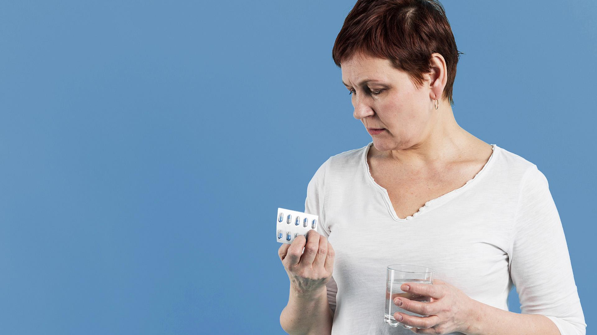
Why women?
Selecting women for our diabetes prediction system
is driven by the recognition that gender-specific
health factors and hormonal influences create
distinct risk profiles.
This targeted approach allows for more
accurate risk assessment and proactive
health management.

Slide 3
Introduction
Background of the Dataset
Our project is centered around addressing a pressing healthcare concern - predicting the risk of diabetes in women.
To achieve this, we've curated a dataset containing crucial health-related parameters, including the number of pregnancies, glucose levels, BMI (Body Mass Index), age, insulin levels, skin thickness, diabetes pedigree function, and blood pressure.
Our primary objective is to construct a robust predictive model that can effectively analyze these factors to provide an accurate forecast of diabetes risk in women.

Slide 4
Identifying the Problem
Planning to generate false or exaggerated health claims regarding the risk of diabetes among women
is known as healthcare insurance fraud.
This type of fraud may involve deceptive practices such as
inflating the severity of health conditions, misrepresenting the health
status of individuals who were not part of the study, or even
fabricating data related to personal health parameters.
Just as insurance fraud in other sectors is unethical and results
in financial losses for the companies, we require effective
methods to reduce these losses for healthcare insurers.
Lower losses translate into better financial performance and more
resources to promote women's well-being through accurate data
analysis and proactive health management.

Slide 5
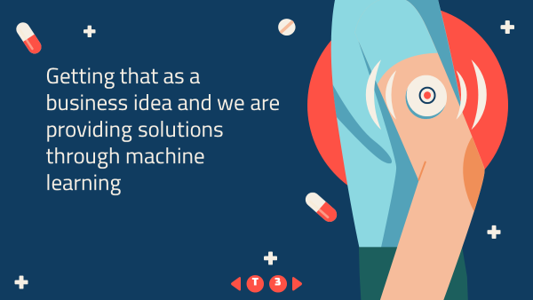
Identify the problem with business goals
Predicting diabetes risk in women is complex due to interrelated factors like genetics and lifestyle. To address this, we're employing machine learning for a precise and efficient model.
This empowers women to manage their health proactively by uncovering hidden patterns in these intricate factors.

Slide 6
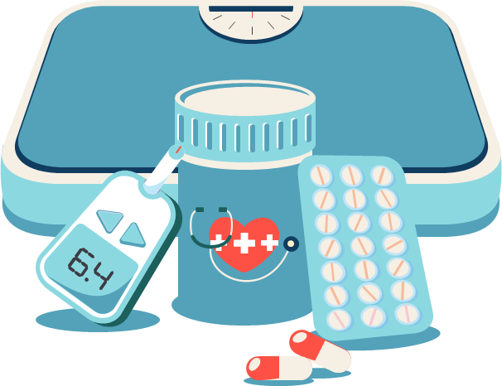
Solutions through Machine Learning
We intend to construct a classification model to address the diabetes risk prediction challenge. Classification aims to use training data to predict the likelihood of data falling into predefined risk categories.
Our model, incorporating K-Nearest Neighbors (KNN), Logistic Regression, Support Vector Machine (SVM), and Random Forest algorithms, will enable users to input their health details and predict their diabetes risk status.
The model will undergo preprocessing and validation before integrating it into a user-friendly front-end application for risk assessment.

Slide 7
After the data identification, we started the process through Machine Learning to build our model.
Data Preprocessing
- Check for missing values
- Check for unique Values
- Check for duplicate Values
Partitioning
- Before feeding the data into the model, the data must split into training and testing sets.
Model Selection
- We had selected classification models.
The
processes
Through
Machine
Learning

Slide 8
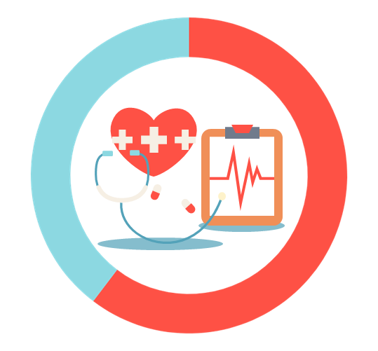
Models we selected in classification
Classification algorithms assign weights to input features to distinguish between two classes. In our "Women's Diabetes Prediction System," we utilized KNN, Random Forest, SVM, and Logistic Regression to ensure accurate predictions.
These models provide the following accuracy values:
K Nearest neighbors: 71.42857142857143
Logistic Regression: 73.37662337662337
Support Vector Classifier: 75.32467532467533
Random Forest: 77.27272727272727
Best Model: Random Forest
Best Accuracy: 77.27272727272727

Slide 9

Explain deploying implementation
In Python and Streamlit, we've constructed and trained our models. These trained models have been saved as serialized objects.
We've created a Streamlit web application featuring an intuitive interface for our users. This interface enables users to input their data and obtain predictions using our pre-trained models.
The Streamlit application streamlines the process, making predictions easily accessible to users.

Slide 10
Thank You…

